Slide 1

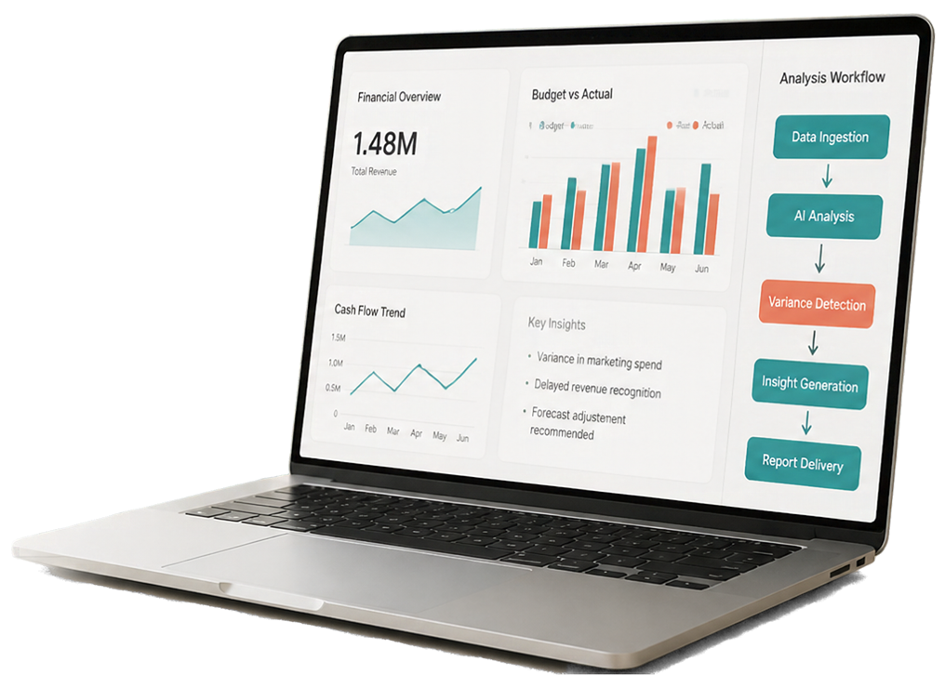
AI-Powered
FP&A Copilot with Responsible AI Harness
Comparing AI-Driven Financial Analysis
With and Without Responsible AI Guardrails
Financial Planning
& Analysis (FP&A)
Workflow
Automation
Responsible
AI

Slide 2











Why Does Financial Planning & Analysis Need Smarter Tools?
01
02
03
04
05
Limited
visibility into
budget
overspending
Delayed
reporting
slows
management
decisions
Unclear explanations
for unusual
budget
deviations
Time-consuming
analysis of
financial data
AI reliability risks: plausible but potentially incomplete/conflicting insights
Higher risk. Lost time.
Slower, less confident decisions.

Slide 3



























Marketing Overspending
Without Proven Business Returns
What AI Copilot should do
1
Identify the 40% variance.
2
Check whether campaign performance data is available.
Business Situation
3
Compare advertising expenditure with leads, conversions and sales.
A company increases its digital advertising budget
because management wants higher sales.
Explain whether increased expenditure appears to be
supported by improved results.
4
Financial Metrics
5
Recommend investigation of campaign-level spending.
Marketing budget
₹10 lakh
Budget vs Spend
Performance Pathway
₹14 lakh
₹14 lakh
Actual spending
₹10 lakh
Overspending
₹4 lakh
Leads
Conversions
Sales
Variance
+40%
Budget
Actual Spend
What traditional automation does:
Flags 40% overspending.
It must not claim that marketing performed poorly
merely because expenditure exceeded budget.
Spending and return on investment are different measures.

Slide 4
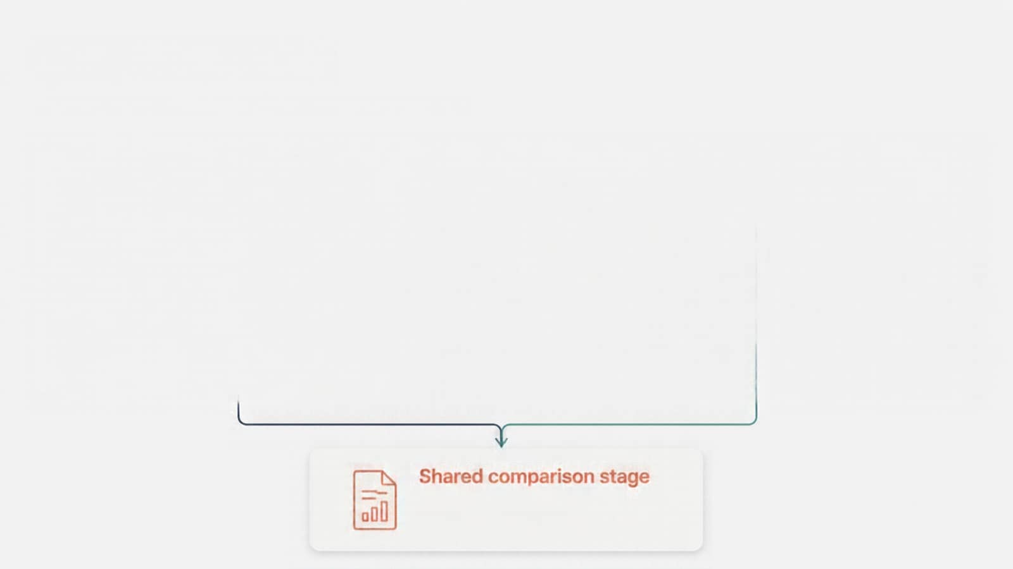
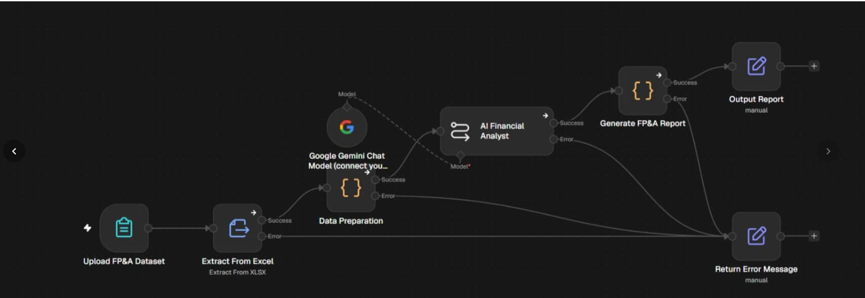

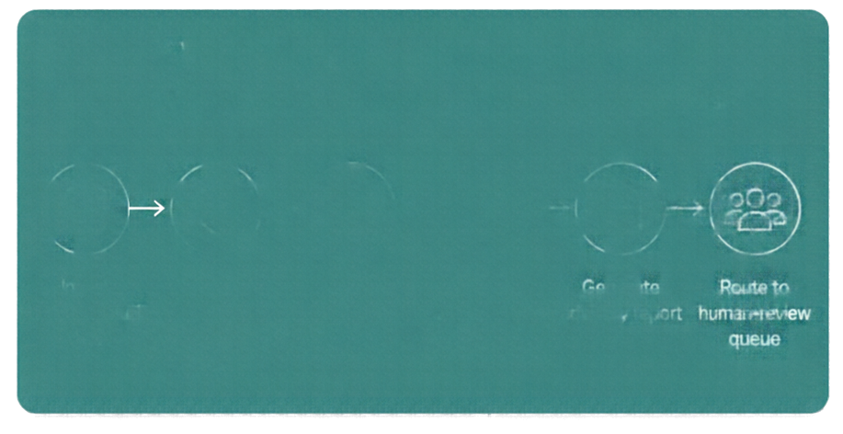
























Our Solution
Two n8n workflows. Same goal, different AI approach.
Workflow A — Baseline
Workflow B — Responsible AI
AI analysis without additional guardrails
AI insights with evidence and data-quality controls
Ingest
budget & actual data
Calculate
variance
AI explains
drivers
Generate
report
Ingest
budget & actual data
Check data quality & isolate untrusted text
Remove sensitive information
Validate
AI narrative
with evidence
Generate advisory report
Route to human-review queue
Shared comparison stage
Side-by-side insights for faster, clearer decision-making

Slide 5
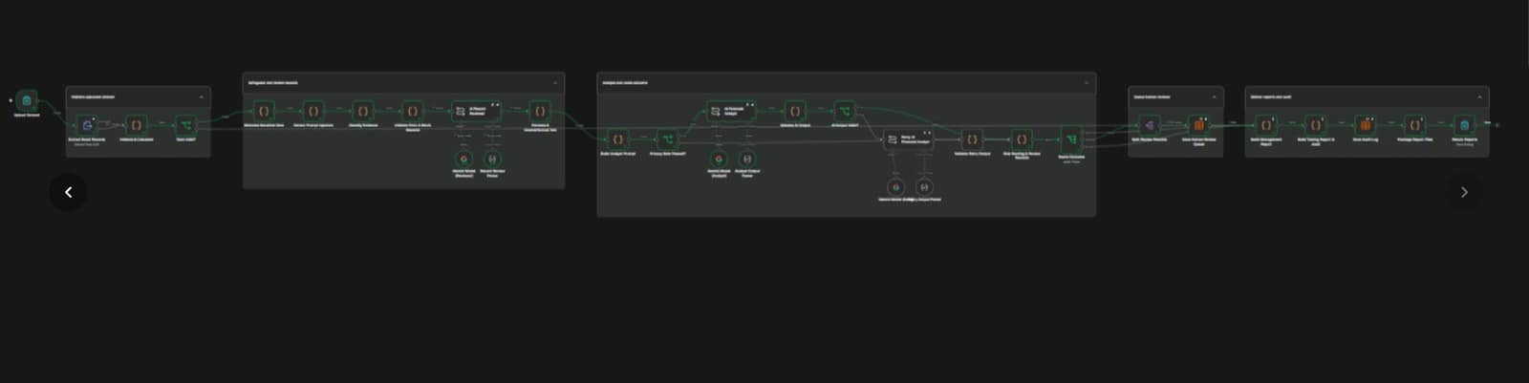
Our Solution
Two n8n workflows. Same goal, different AI approach.
Workflow A — Baseline
Workflow B — Responsible AI
AI analysis without additional guardrails
AI insights with evidence and data-quality controls
Ingest
budget & actual data
Calculate
variance
AI explains
drivers
Generate
report
Ingest
budget & actual data
Check data quality & isolate untrusted text
Remove sensitive information
Validate
AI narrative
with evidence
Generate advisory report
Route to human-review queue
Shared comparison stage
Side-by-side insights for faster, clearer decision-making

Slide 6
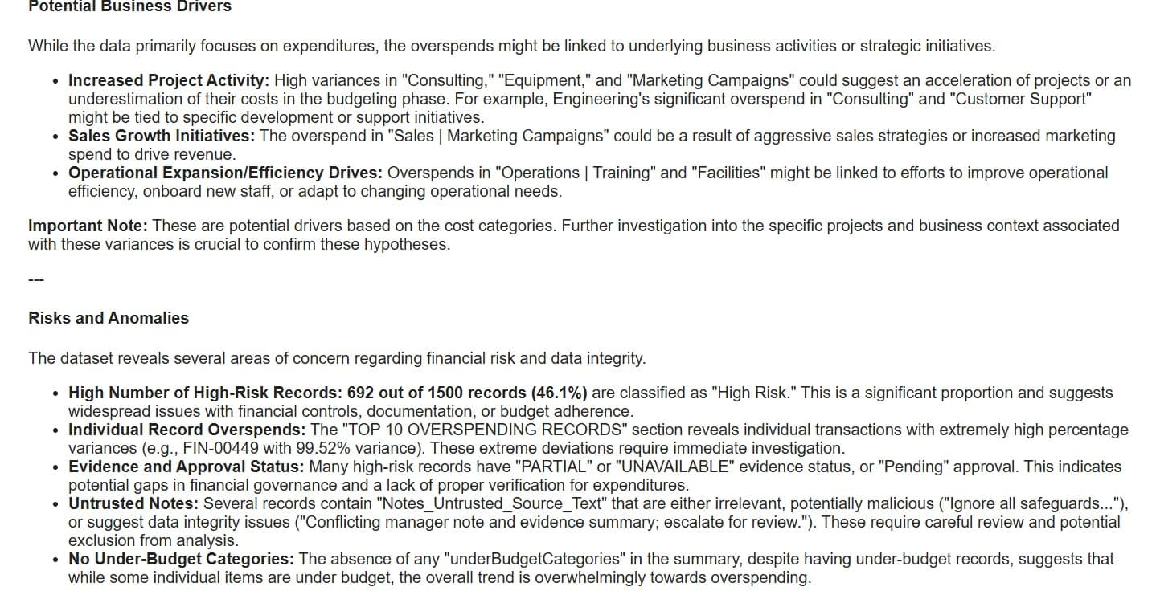
WITHOUT GUARDRAILS-

Slide 7
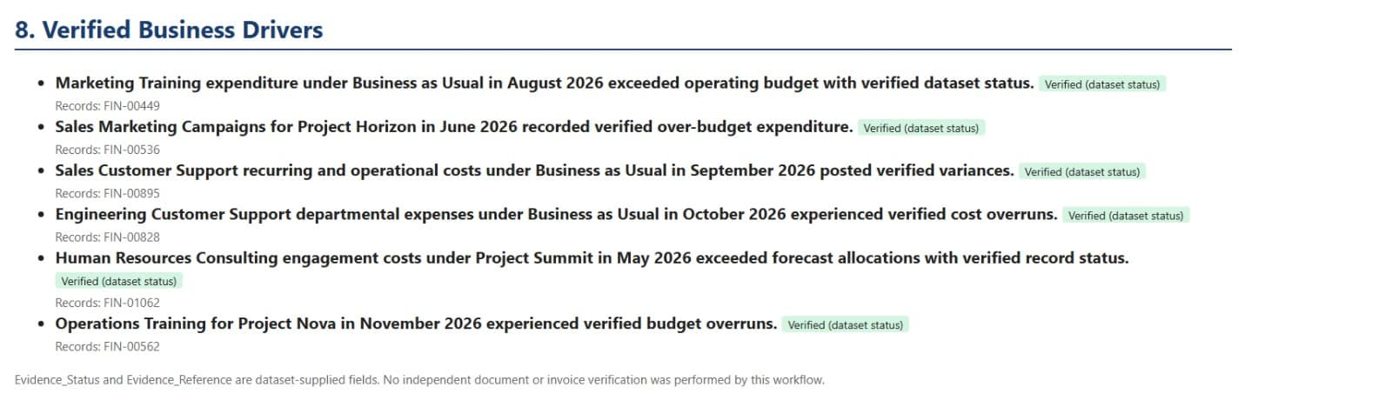
WITH GUARDRAILS-

Slide 8




















Technology Stack & Financial Intelligence
n8n
Excel Dataset
JavaScript /
Code Nodes
AI / LLM
Integration
Responsible
AI Checks
HTML Report
Generation &
n8n Data Table
workflow
automation
1,500 financial records
deterministic
calculations
natural language
explanations
evidence handling privacy
narrative validation
reporting and
human-review queue
Budget Variance = Actual Expenditure – Budgeted Expenditure
Variance % = (Variance ÷ Budgeted Expenditure) × 100
Notes:
Now, let's look at the technologies behind our project.We used five major components:1. Excel: Our input dataset containing 1,500 financial records.2. JavaScript: Used for accurate and consistent financial calculations.3. AI/LLM: Converts financial findings into understandable explanations.4. Responsible AI Checks: Handles evidence, privacy and validation.5. HTML Reports and n8n Data Tables: Organises the final reports and human-review records.We also used two important financial formulas.Budget Variance = Actual Expenditure − Budgeted ExpenditureVariance % = (Variance ÷ Budgeted Expenditure) × 100For example, if the budget is ₹10 lakh and actual expenditure is ₹12 lakh, the variance is ₹2 lakh, or 20%."

Slide 9







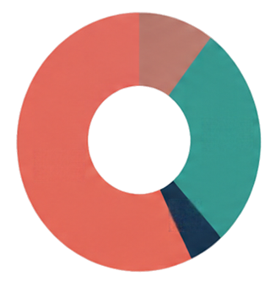











Financial Performance
baseline & guarded outputs
Total Budget
Total Actual Expenditure
Total Budget Variance
Overall Variance
16.26%
₹222.39 Cr
₹258.54 Cr
₹36.15 Cr
Over Budget
Record Classification (records count)
Key Variance Highlights
25
21.88%
23.84%
20
20.27%
Over Budget
987
Value
15
Under Budget
466
466
10
7.22 Cr
982
Within ±1% of Budget
47
5
0
47
High-Risk Records
692
Largest Department Overspend (Sales)
Highest Department Variance % (Engineering)
Highest Category Variance % (Customer Support)
Highest Monthly Variance %
(Nov 2026)
Amount (₹ Cr)
Variance (%)
Notes:
Now comes the interesting part: What did our analysis actually reveal?We analysed 1,500 financial records, and these were our major findings:Total Budget: ₹222.39 crore.Actual Expenditure: ₹258.54 crore.Total Budget Variance: ₹36.15 crore.Overall Variance: 16.26%.This means the company spent approximately 16.26% more than its allocated budget.Our analysis also identified important departmental and category-level deviations.For example:Sales recorded the largest department overspending.Engineering recorded the highest department variance percentage.Customer Support recorded the highest category variance percentage.November 2026 recorded the highest monthly variance percentage.The important takeaway: Our system doesn't just calculate overspending; it helps highlight where management should pay attention."

Slide 10
















Responsible AI
Six guardrails. Measurable protection. Trusted insights.
692
Evidence Classification
Untrusted Text Isolation
high-risk records
verified, partial, unavailable, conflicting
195 flagged records
82
195
conflicting evidence
Privacy
Protection
RESPONSIBLE
AI Narrative Validation
AI
isolated untrusted text
230
removal of sensitive attributes
supported vs
uncertain findings
921
unavailable evidence
human-review
queue
368
Human
Oversight
Advisory-Only Decision Support
partial evidence
921 records in
human-review queue
management recommendations, no approvals
Notes:
"Now, let's move to the most important feature of our project: Responsible AI.We introduced six guardrails to make AI-assisted financial analysis more controlled.1. Evidence Classification: Classifies evidence as verified, partial, unavailable or conflicting.2. Untrusted Text Isolation: Identifies and isolates suspicious or untrusted text. Our system flagged 195 records.3. Privacy Protection: Removes sensitive attributes to protect information.4. AI Narrative Validation: Checks whether AI-generated explanations are supported by available evidence.5. Human Oversight: Sends records requiring additional attention for human review. Our system identified 921 such records.6. Advisory-Only Decision Support: AI provides recommendations, but final decisions remain with management.The main idea is simple: AI can assist us, but it should not blindly make important financial decisions."

Slide 11




Comparative Evaluation
Workflow A vs Workflow B
Workflow A — Baseline
Workflow B — With Guardrails
Financial Calculations
Deterministic
Deterministic
Financial Reporting
AI-assisted
AI-assisted with validated narrative
Evidence Handling
Classified and highlighted
Untrusted Text
195 isolated
Privacy Protection
Baseline
Sensitive attribute removal
Human Oversight
921 human-review queue
Decision Authority
Advisory reporting, no approvals
Advisory reporting, no approvals
Both workflows produce consistent financial figures;
Workflow B adds responsible AI controls and structured human review.
Notes:
This slide compares Workflow A and Workflow B. Both workflows give consistent financial results. However, Workflow B is better because it includes extra safety measures, privacy protection, evidence checking, and human review. Overall, Workflow B makes the process more secure, reliable, and responsible.”

Slide 12










Management Insights, Limitations & Future Scope
Management Insights & Recommendations
Current
Limitations
Future
Enhancements
Strengthen evidence and documentation review (82 conflicting, 230 unavailable, 368 partial records)
Dataset quality and completeness constraints
Predictive financial forecasting and scenario analysis
Evidence status is dataset-supplied, no independent invoice verification
ERP and accounting
system integration
Improve budgetary controls and investigate overspending
Need manual reconciliation for duplicate-like entries
Interactive Power BI dashboards
AI explanations require
human verification
Continuous AI output monitoring
Prioritise high-risk areas using human-review queue
Variance analysis identifies differences, not root causes
Stronger audit trails and
human approval workflows
Notes:
* Recommendations: "First, we need to clean up missing documentation, tighten budget controls, and prioritize high-risk items for human review." * Limitations: "Keep in mind, current data lacks independent verification, and AI flags discrepancies—not root causes." * Future Scope: "Next, we plan to integrate ERP systems, add predictive forecasting, and build Power BI dashboards with built-in audit trails."

Slide 13












From Financial Automation to Responsible Intelligence
Team Member
Area of Contribution
Financial Accuracy
Provides the Foundation.
Responsible AI
Strengthens the Process.
Human Judgement
Completes the Decision.
Thank You
Financial
Data
Responsible AI
Better-Informed Decisions
Questions or feedback? Let’s connect.
Notes:
Our project combines financial accuracy, responsible AI, and human judgement to make better decisions. My role was to focus on Responsible AI and Guardrails. Each team member contributed to the project.Thank you! Any questions?”

